Slide 1
git & GitLab
backup, version control & project management

Slide 2
Backup
Do it! Do IT reliably! Do it regularly!

Slide 3
Why backup?
“I lost my work” is not a valid excuse for missing a deadline
Capstone document describes harsh penalties for failing to submit on time
Repeating work is a waste of time

Slide 4
You must backup
Hardcopy: scan to get a softcopy
Softcopy: many strategies

Slide 5
Successful / unsuccessful backup
Successful backup is
Easy / low effort / no effort
Easy & fast to restore lost data
Several previous versions, not just 1 or 2
Offsite / multiple location / multiple platform storage
Regular
Unsuccessful backup is
None
Working on a USB stick only

Slide 6
Data can be lost to
User error
Commercial online backup system fails
Commercial online backup company goes out of business
Loss of computer
Theft of computer
Loss of USB stick
Failure of USB stick
Corruption of USB stick
Mechanical failure of USB stick
Hard disk corruption: malware
Hard disk failure: age
Mould
Fire
Flood
Loss of paper notes

Slide 7
Data can be lost to In the last 10 years I have lost data to
User error
Commercial online backup system fails
Commercial online backup company goes out of business
Loss of computer
Theft of computer
Loss of USB stick
Failure of USB stick
Corruption of USB stick
Mechanical failure of USB stick
Hard disk corruption: malware
Hard disk failure: age
Mould
Fire
Flood
Loss of paper notes

Slide 8
Version control

Slide 9
Why version control?
Even “incorrect” first attempt may be useful
Better not to delete as there may be correct parts
Or the whole thing might be correct!
An edit to code may introduce errors
Roll back to previous version
Clearly view difference (diff) between versions to find source of error

Slide 10
You must implement version control
Hard copy
Soft copy
“Incorrect” work should not be
Erased
Made illegible with ink
Thrown away
Neatly mark as incorrect and file
Do not edit or overwrite in a way that destroys the original “incorrect” version

Slide 11
Successful version control is
Keep every version forever
At appropriate intervals
Regular
But not excessive
I keep a version approx. every 2 hours of work
Well indexed
Well documented / labelled
Minor correction: a couple of words or a sentence is enough
New feature: a paragraph or more of documentation including (possibly) reasoning behind new feature

Slide 12
Proper documentation because
You will have forgotten what you did 3 months ago, but need to understand it when you write up
Being forced to explain makes you think through ideas better
Your capstone supervisor may need to understand why you did something
Write documentation as if it is for someone else

Slide 13
Project management

Slide 14
Why project management?
Avoid running out of time or missing interim deadlines
Avoid wasting time on solving unnecessary problems
Avoid wasting time on ineffective solutions (coding / proving / reading / learning) to problems
Avoid repeating work
Write up efficiently

Slide 15
The capstone is a much bigger undertaking than any project yet
Total days between start and finish
You will forget things you have done
You will forget how you did things
You will forget why you did things
Full time equivalent days spent working on the project
44 days full time work
Complexity of overall task
Subtasks
Evolving goals
Interim deliverables
Interim deadlines

Slide 16
Problem complexity
Example of problem that can be solved in your head
x + 3 = 5
Example of problem that cannot be solved in your head
x + 3 y + z = 2, 2 x + y – 5 z = 1, x – y + 4 z = 7
The complex problem can only be solved by working on paper
As you solve the problem, you record the result of each step
Record the results of taking certain linear combinations of the equations to eliminate certain variables
Record the values of x, y, z as you find them
because otherwise you would forget

Slide 17

Task complexity
Even the complex problem could be solved without any planning
Example of task that can be planned in your head (IBVP)
Solve $u_{t}=k u_{xx}$ on $\left(x,t\right)∈\left(0,L\right)×(0,∞)$ with $u\left(x,0\right)=u_{0}(x)$, $u\left(0,t\right)=0$, $u_{x}\left(L,t\right)=0$.
This can be broken into subtasks
Separate variables to get an ODE in time and SLP in space
Solve SLP to get basis of eigenfunctions and eigenvalues
Solve temporal ODE to get time evolution of each eigenfunction
Assume $u(x,t)$ is a linear combination of separated solutions, evaluate at $t=0$ and use basis property to calculate coefficients
Each of these subtasks is at least as complicated as solving the complex problem (linear system)

Slide 18
Task complexity
The whole task (IBVP) can be solved in approx. ¼ hour
Scale up from 15 minutes to the capstone
2 modules * 5MC * 14 weeks * 2.5 hours / week / MC = 350 hours
So 1400 times the task duration & complexity.
You cannot plan the task of a capstone in your head

Slide 19
Successful project management
Allows tasks to evolve
Keeps track of how & why that evolution occurred
Can be understood by collaborators
Audited by supervisor
Graded by supervisor & examiner
Allows tasks to be tied to interim deadlines
Allows tasks to reference other tasks (subtasks)
Allows tasks to be linked to versions in the version control system

Slide 20
git / gitKraken / GitLab
For backup, version control & project management

Slide 21
Division of labour
git
Version control software
Runs on command line
gitKraken
GUI for git
Unnecessary if you are comfortable on command line, but very quick to learn if you are not
GitLab
Project management
Share git repositories
Backup git repositories

Slide 22
Learning git & gitKraken
git allows you to save and navigate a digraph of versions of your project
All versions are saved
Only diffs are recorded, to efficiently store data
Allows merging of two different branches representing different tasks
git works best with plain text source files
Some binaries (eg images) cannot be avoided
But only save LaTeX source files or markdown (don’t use MSWord)
See supplementary materials on learning git & gitKraken
Book Pro Git https://git-scm.com/book/en/v2 chapters 1-3
Introduction to git & gitKraken

Slide 23
What is GitLab?
Web service for hosting git repositories
Backup your repository to the cloud
Share your repository between multiple computers and collaborators
Your supervisor may want to see your repository
Advanced project management features through “Issues”
github is very similar, but GitLab is open source (open core) so you can run your own server if you like
More advanced GitLab workflow / project management at https://www.youtube.com/watch?v=enMumwvLAug

Slide 24
git-enabled problem workflow
make edits
write commit message to describe version & document edits
commit
loop

Slide 25
git-enabled problem workflow with backup
make edits
write commit message to describe version & document edits
commit
loop
push to remote (GitLab)

Slide 26
GitLab-enabled task workflow
identify new task / bug / feature & open GitLab issue
refine description of task by posting in GitLab issue, break into subtasks with their own issues
assign task to project deadline
break task into problems
problem workflow loop until significant progress made
document progress in GitLab issue, linking commits
loop until task complete
close issue

Slide 27
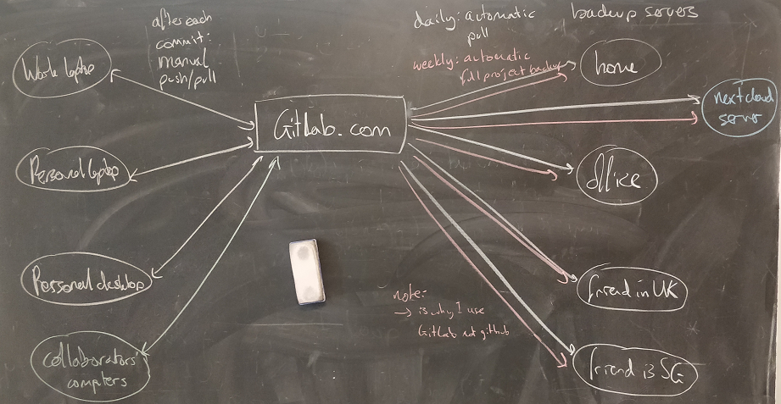
My git-enabled backup strategy

